Slide 1

Android App Development For Newbies
by Geniobits

Slide 2

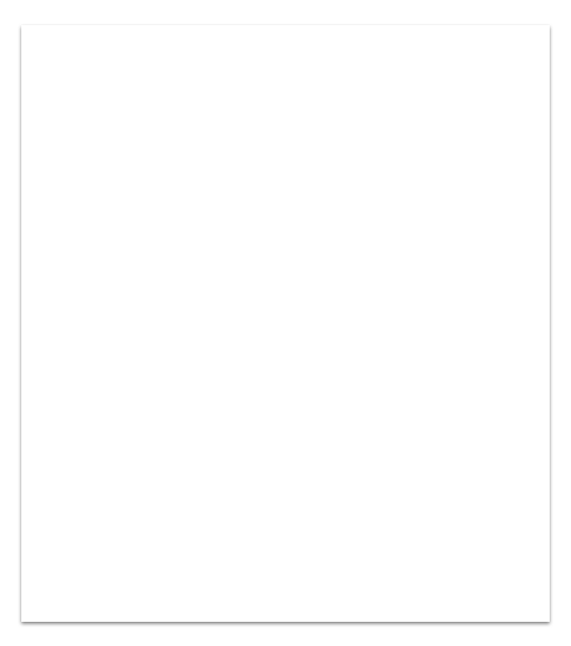
Who is this course for?
Do you want to
Master android development,
Make small fortune and
Retire as billionaire?
Do you prefer
Practical approach and
Not theory lectures?

Slide 3
What is android? Android is a mobile operating system based on a modified version of the Linux kernel and other open source software, designed primarily for touchscreen mobile devices such as smartphones and tabs.
Interesting fact
Android Green Robot Logo Was Inspired By Bathroom Sign.

Slide 4
Android Version Name Is Based On The Sweet Treats
Android 1.5: Android Cupcake
Android 1.6: Android Donut
Android 2.0: Android Eclair
Android 2.2: Android Froyo
Android 2.3: Android Gingerbread
Android 3.0: Android Honeycomb
Android 4.0: Android Ice Cream Sandwich
Android 4.1 to 4.3.1: Android Jelly Bean
Android 4.4 to 4.4.4: Android KitKat
Android 5.0 to 5.1.1: Android Lollipop
Android 6.0 to 6.0.1: Android Marshmallow
Android 7.0 to 7.1: Android Nougat
Android 8.0 to Android 8.1: Android Oreo
Android 9.0: Android Pie
Interesting fact
As you all know all android version are named after desserts but
two of the android version are not named after desserts is Android 1.0 (Astro) and Android 1.1 (Bender).

Slide 5
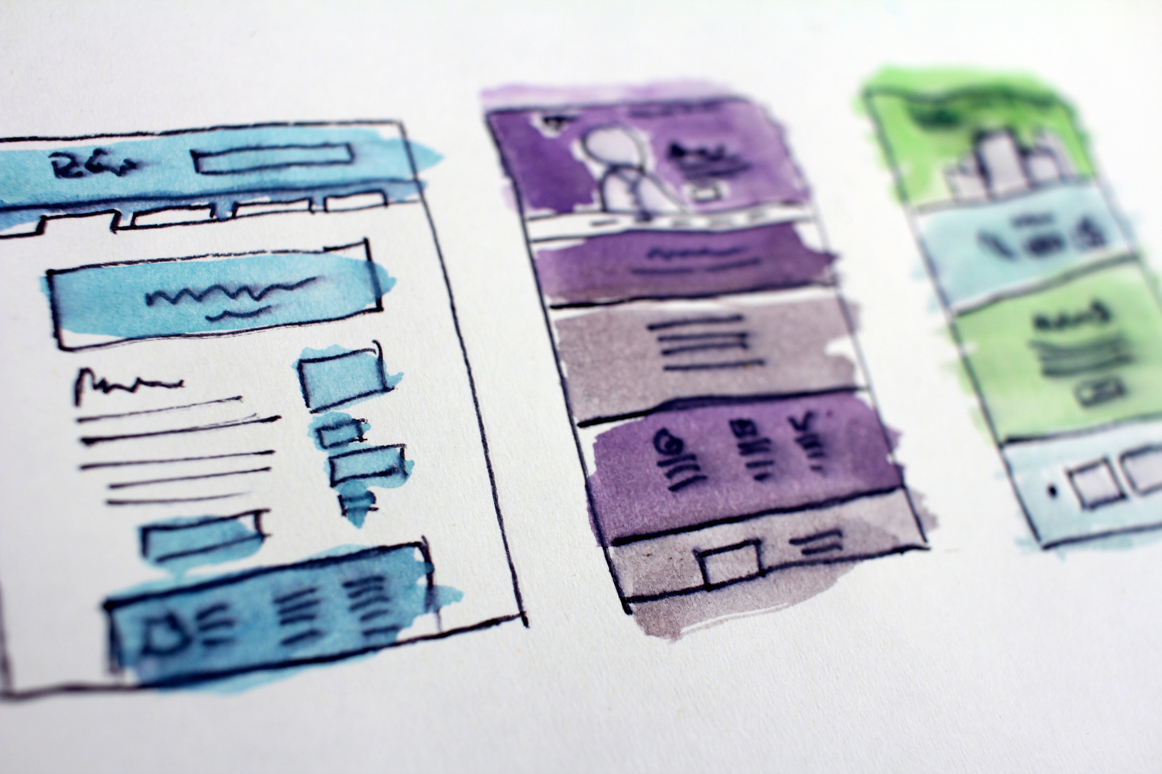
How android development will be useful to you?
Huge market
Open source code – Make what you want
Carrier opportunities
Good revenue
Penetration on Different devices
Gradual Learning Curve

Slide 6

Lets Revise Java First
Create a program which accepts age as a string from user and converts it into int and calculates user’s year of birth.

Slide 7
Lets Revise Java First
Student management sys-
1. Take and store students full name, div, roll num
2. Search students by name
3. Search students by roll num
4. Delete by roll num
5. Edit data of student by roll num
Use Classes, ArrayList, String manipulation, Switch case

Slide 8
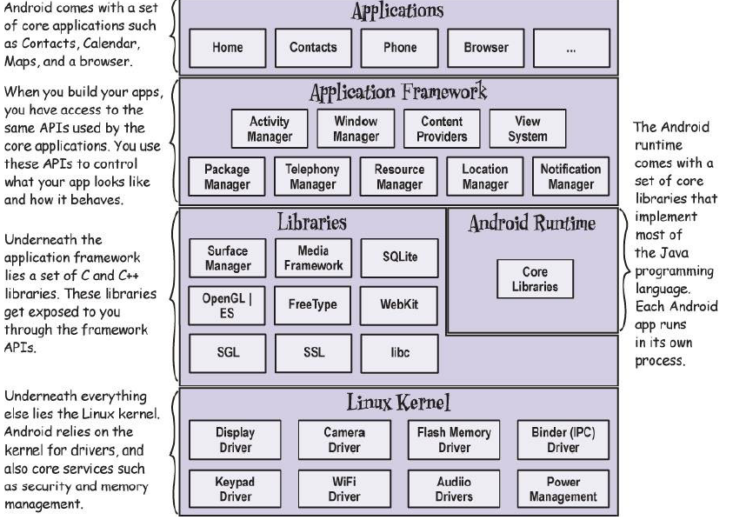

Slide 9
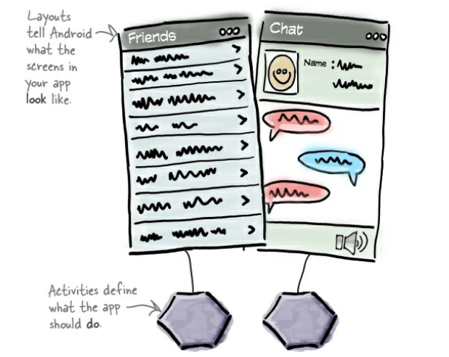
Android Layouts And Activities Layouts only define the appearance of the app. You define what the app does by writing Java code. A special Java class called an activity decides which layout to use and tells the app how to respond to the user.

Slide 10
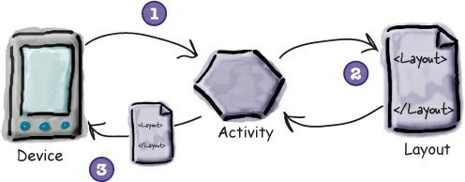
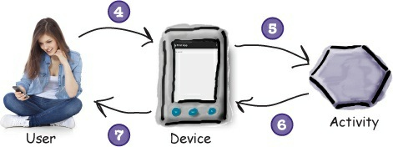
1. The device launches your app and creates an activity object.
2. The activity object specifies a layout.
3. The activity tells Android to display the layout on screen.
4. The user interacts with the layout that’s displayed on the device.
5. The activity responds to these interactions by running application code.
6. The activity updates the display...
7. ...which the user sees on the device

Slide 11
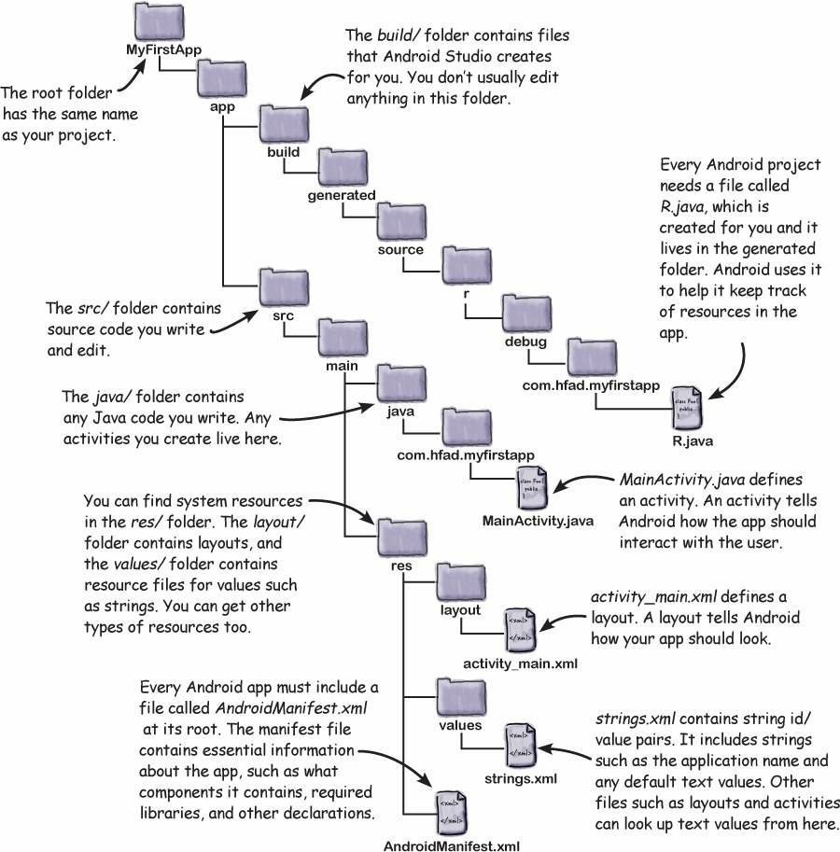

Slide 12
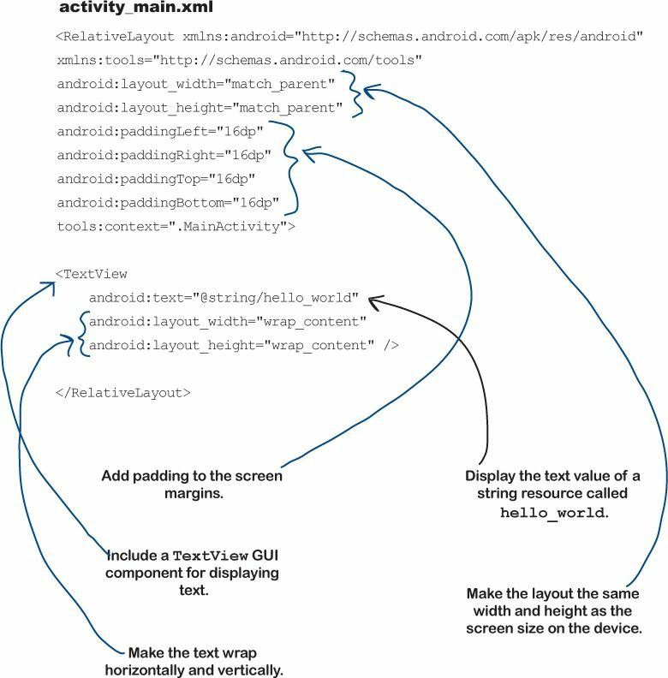

Slide 13
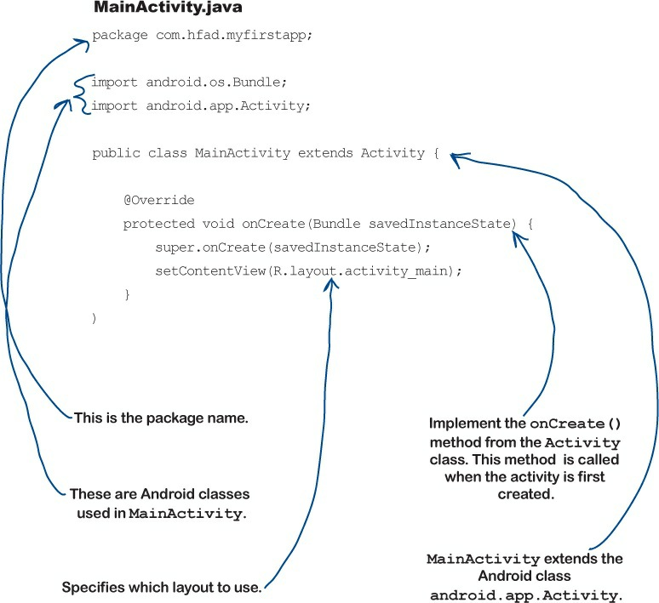

Slide 14
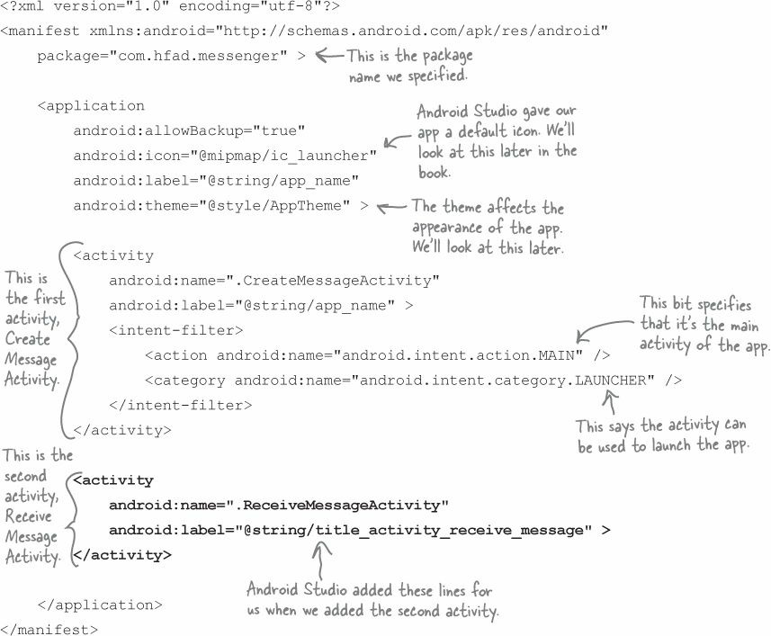
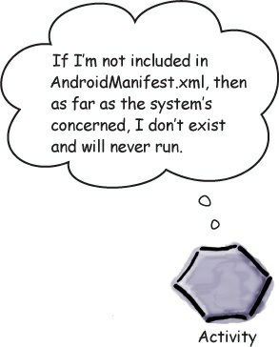
Welcome to the Android manifest file

Slide 15
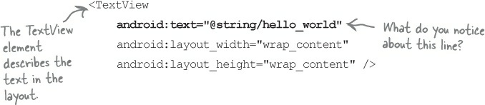
Why @string?
This is just a way of telling Android to look up a text value from a string resource file. In our case, Android Studio created a string resource file for us called strings.xml, located in the app/src/main/res/values
Localization
To make it available internationally and for different languages.

Slide 16
Making Random number generator
Generate number button on click will Generate 5 digit random
Number and show in the text view.

Slide 17
Making Basic App that do something
by Geniobits

Slide 18
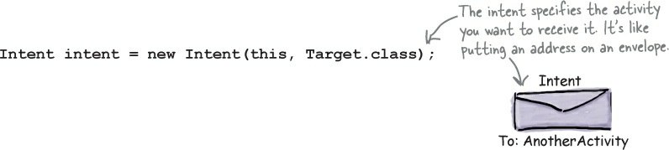
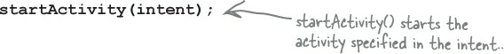
What's your Intent? An intent is a type of message

Slide 19
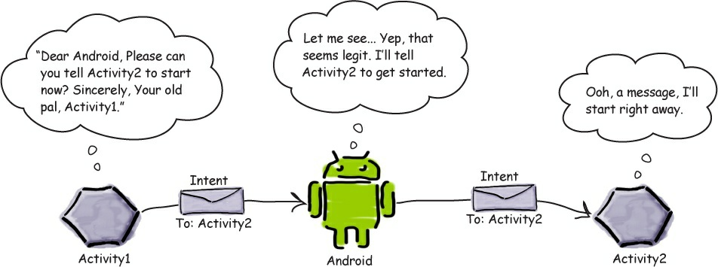
How Intent work? Once Android receives the intent, it checks everything’s OK and tells the activity to start. If it can’t find the activity, it throws an ActivityNotFoundException

Slide 20
Creating small messenger
Create send and receive message activities. Use Intent to send message.

Slide 21
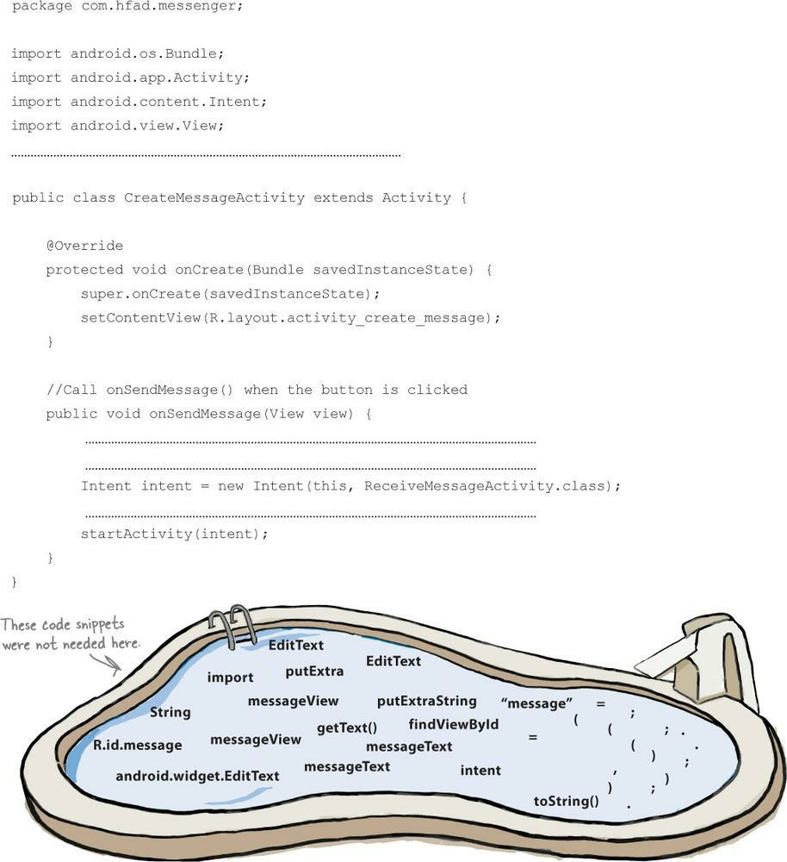

Slide 22
Intents
Launching Intents
Explicitly: by reference to the activity’s class name
Implicit: By name, action, category, data type, or data URI
Intents expecting return value: The launched activity returns result handled by the initiating activity’s callback method

Slide 23
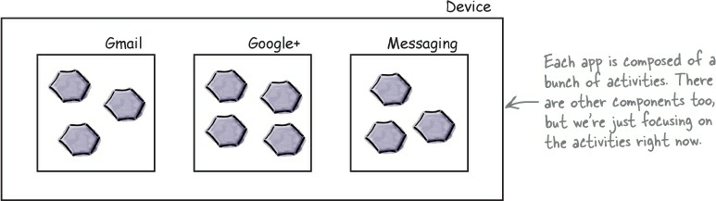
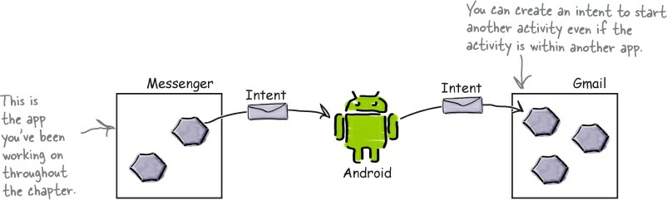
App is Set of Activities

Slide 24
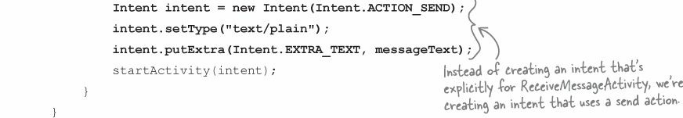
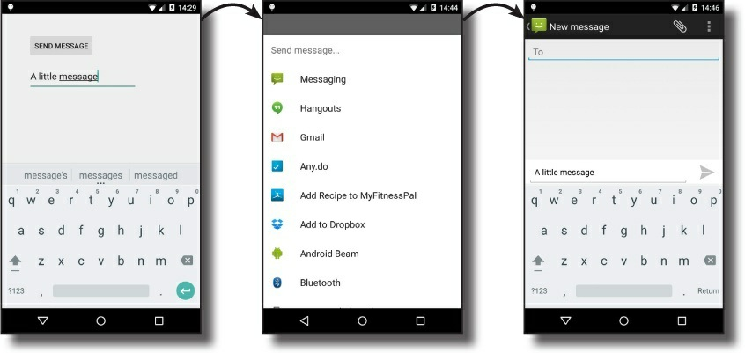

Slide 25
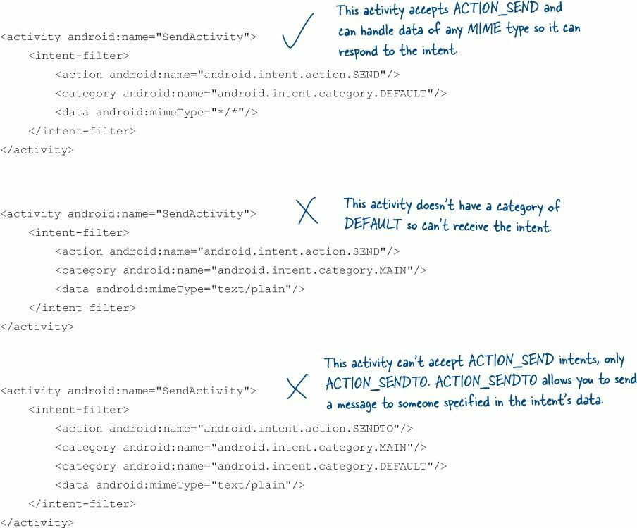

Slide 26
Launchable Android Provided Activities
Open a browser window
public static void invokeWebBrowser(Activity activity)
{ Intent intent = new Intent(Intent.ACTION_VIEW);
intent.setData(Uri.parse("http://www.google.com"));
activity.startActivity(intent); }
Call a telephone number
public static void call(Activity activity)
{ Intent intent = new Intent(Intent.ACTION_CALL);
intent.setData(Uri.parse("tel:555-555-5555"));
activity.startActivity(intent); }
Present a phone dialer
public static void dial(Activity activity)
{ Intent intent = new Intent(Intent.ACTION_DIAL);
activity.startActivity(intent); }

Slide 27
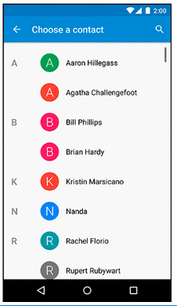
Accessing the contact list
final Intent pick = new Intent(Intent.ACTION_PICK,
ContactsContract.Contacts.CONTENT_URI);
startActivityForResult(contract, REQUEST_CONTACT);
public void onActivityResult(int code, int result, Intent data) {
If (result != Activity.RESULT_OK) { return; }
} else if (code==REQUEST_CONTACT && data !=null) {
URI contactUri = data.getData();
String[] queryFields = new String[] {
ContactContract.Contacts.DISPLAY_NAME };
Cursor c = getActivity().getContentResolver()
.query(contactUri, queryFields, null, null, null);
try { if (c.getCount() == 0) ) { return; }
c.moveToFirst();
String suspect = c.getString(0);
mCrime.setSuspect(suspect);
mSuspectButton.setText(suspect);
} finally { c.close(); }
}
}

Slide 28
Activity life cycle
Android

Slide 29
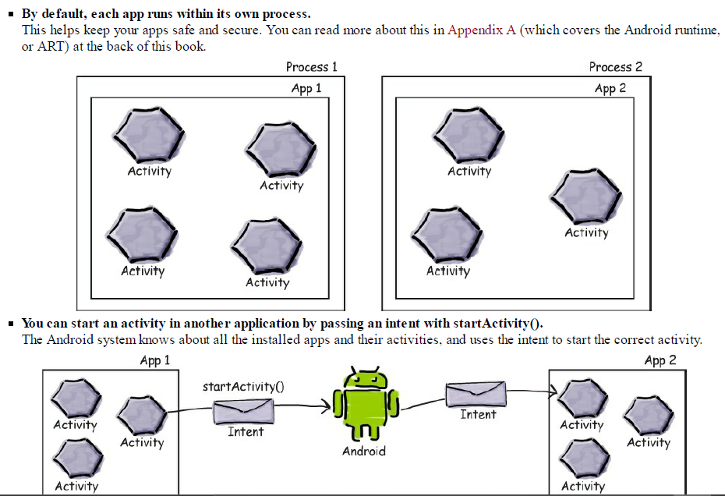

Slide 30
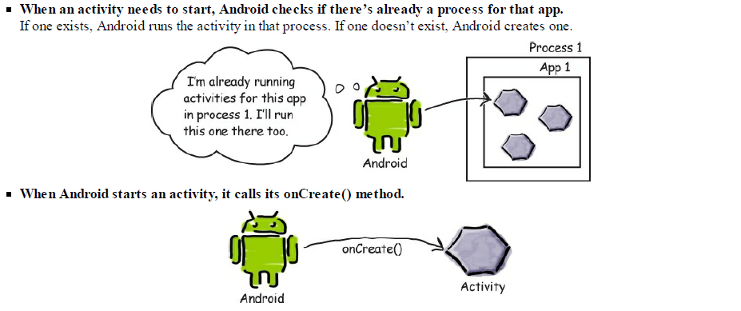

Slide 31
WHAT Is activity life cycle?
It is a set of predefined states in which an activity can be
[create, start, pause, resume, stop, restart, destroy]
The 7 lifecycle method of Activity describes how activity will behave at different states.
As a user navigates through the app, Activity instances in your app transition through different stages in their life-cycle.
The Activity class provides a number of callbacks that allow the activity to know that a state has changed

Slide 32
Activity life cycle
onCreate( );
when the activity is first created.
onStart( );
when the activity becomes visible to the user
onPause( );
when the current activity is being paused
onResume( );
when the user starts interacting with the application
onStop( );
when the activity is no longer visible
onRestart( );
when the activity restarts after stopping it
onDestory( );
before the activity is destroyed by the system

Slide 33
Launched
onCreate( )
onRestart( )
onStart( )
onResume( )
Activity Running
onPause( )
onStop( )
onDestory( )
End

Slide 34
nutshell.Geniobits.com
Android development

Slide 35
Let’s do it practically

Slide 36
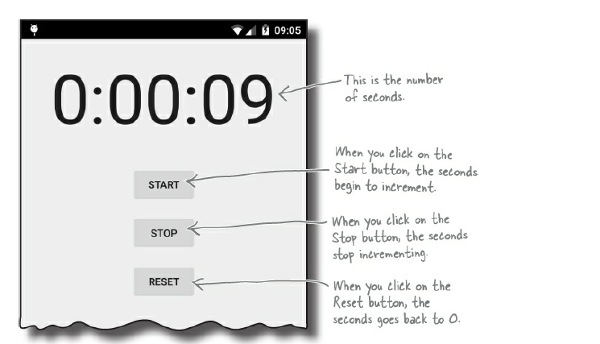

Slide 37
Handlers
Android

Slide 38
Private Boolean isRunning;
Private int seconds;
00:00:00
Start
isRunning = true;
onClick( )
Stop
onClick( )
isRunning = false;
Reset
onClick( )
isRunning = false;
seconds = 0;

Slide 39
Post Handler
You should use handler.post( ) whenever you want to do operations on the UI thread
Ex. Changing textView text or color or any other UI related stuff.
So let's say you want to change a textView's text in the callback. Because the callback is not running on the UI thread, you should use handler.post( ).
In Android, as in many other UI frameworks, UI elements (widgets) can be only modified from UI thread.

Slide 40
Post Handler
Syntax
Handler mHandler = new Handler();
mHandler.post(new Runnable() {
@Override
public void run () {
}
});

Slide 41
Post delay handler
Text
It’s similar to Handler.post( )
The speciality is we can execute a code block after a specific time i.e. adding delay
Syntax:
handler.postDelay(new Runnable, delayInMili);

Slide 42
Post delay Handler
Syntax
Handler mHandler = new Handler();
mHandler.postDelayed(new Runnable() {
@Override
public void run () {
}
}, 1000); // 1 second = 1000 milliseconds;

Slide 43
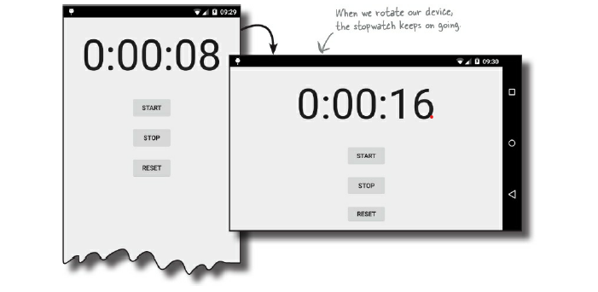

Slide 44
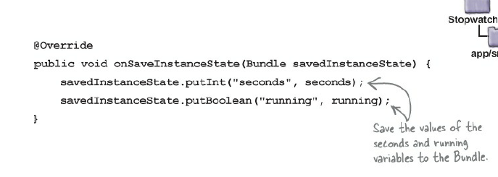
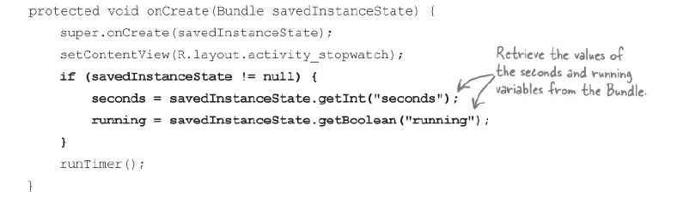

Slide 45
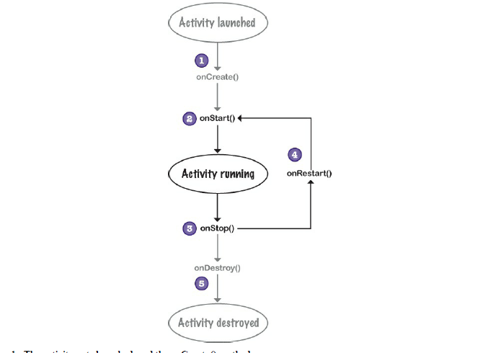

Slide 46
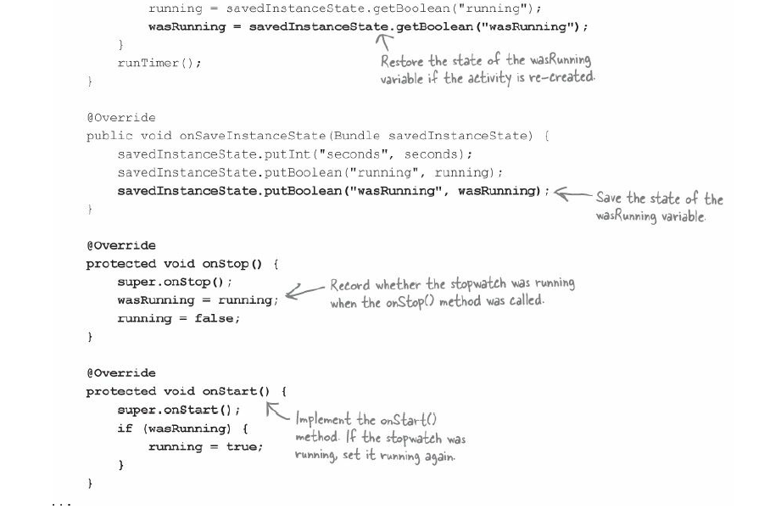

Slide 47
nutshell.Geniobits.com
Android development

Slide 48
Views part-1
Android

Slide 49
Three important views
Relative
Linear
Grid

Slide 50

Relative view
Relative
In relative layout widgets are positioned relative to other widgets [views and widgets can be use interchangeably]
You can choose to position a imageView at the top, an editText below an imageView, a button to the right side of the editText, etc.
We are assigning the position values of a view relative to other views or to the parent view
Message
Send

Slide 51
Linear view
A linear view displays widgets next to each other either vertically or horizontally
If orientation is vertical, widgets will be arranged in a single column
If orientation is horizontal, widgets will be arranged in a single row
Message
Send

Slide 52
Relative view
android:layout_alignParentBottom | Aligns the bottom edge of the view to the bottom edge of the parent.
android:layout_alignParentLeft | Aligns the left edge of the view to the left edge of the parent.
android:layout_alignParentRight | Aligns the right edge of the view to the right edge of the parent.
android:layout_alignParentTop | Aligns the top edge of the view to the top edge of the parent.
android:layout_centerInParent | Centers the view horizontally and vertically in the parent
android:layout_centerHorizontal | Centers the view horizontally in the parent.
android:layout_centerVertical | Centers the view Vertically in the parent.
How to positioning views
as per parent view?

Slide 53
Text
Video Name
12951205
535 likes

Slide 54
Grid view
It divides a screen into grid of rows, columns, and cells
You have to specify where your widget should be present
You have to specify how much column or row span it requires
Message
Send

Slide 55
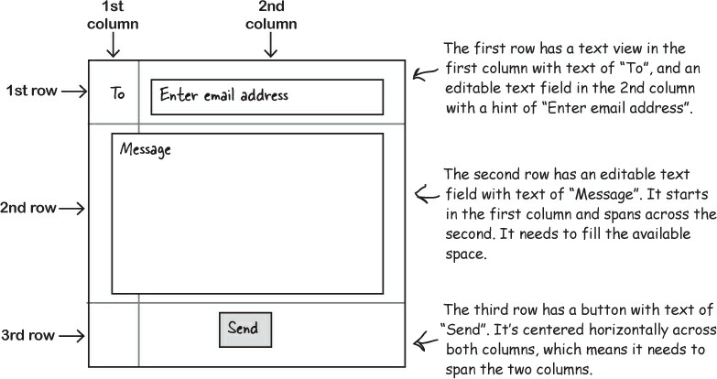

Slide 56
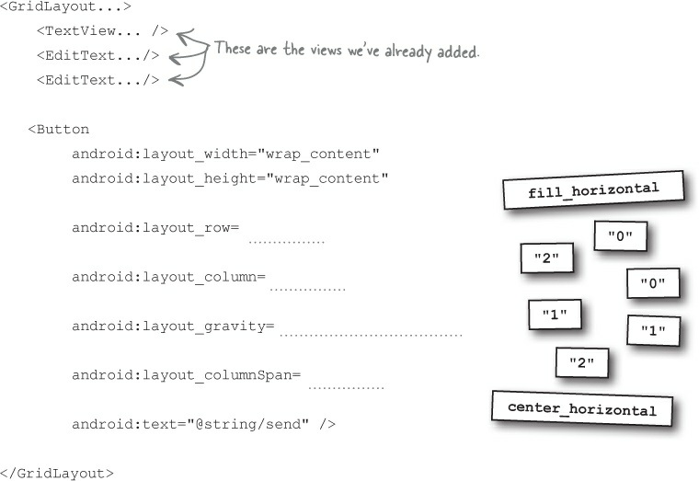

Slide 57
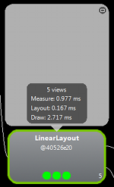
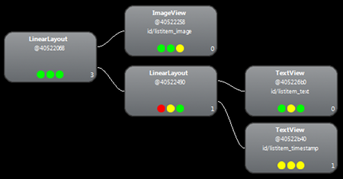
More Complexity →Example of Nested LinearLayouts
Here have First LinearLayout (vertical) that contains ImageView and then another LinearLayout (itself has 2 TextViews)
ImageView
2 TextViews

Slide 58
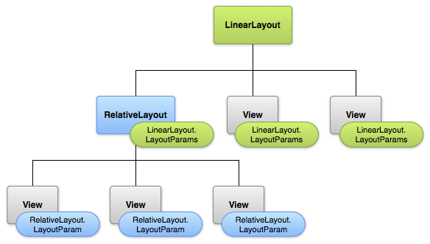
You can nest Any kind of Layouts –like here
you can have a ViewGroup (another Layout) inside as a member of the LinearLayout to make a more COMPLEX interface

Slide 59
More Views Hierarchy of Views
a. Text view
b. Edit Text
c. Button
d. Toggle button
e. Switch
f. Check boxes
g. Radio buttons
h. Spinner
i. Image View
j. Image Button
k. Scroll views
l. Toasts

Slide 60
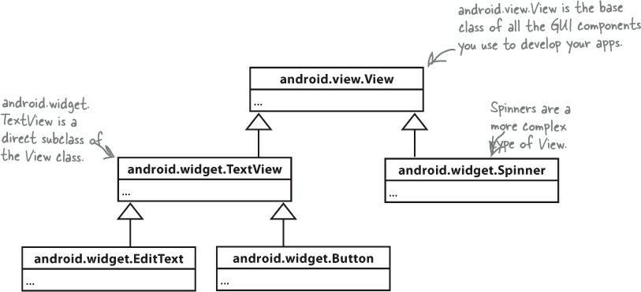
GUI components are a type of View
This is because all layouts and GUI components are subclasses of the Android View class

Slide 61
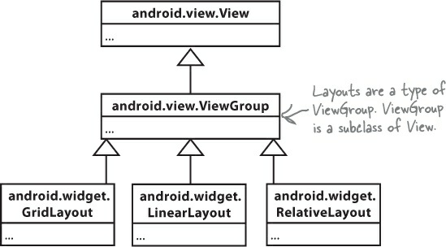
Layouts are a type of View called a ViewGroup

Slide 62
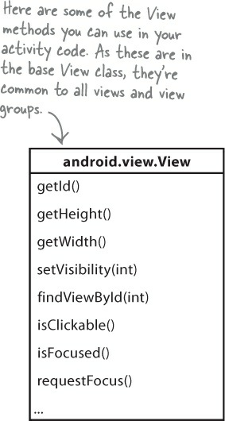
Default methods of view class

Slide 63
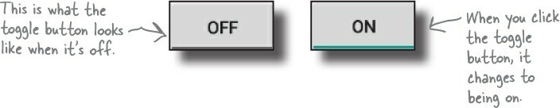
Toggle button
<ToggleButton
android:id="@+id/toggle_button"
android:layout_width="wrap_content"
android:layout_height="wrap_content"
android:textOn="@string/on"
android:textOff="@string/off" />
toggleAlarm.setOnCheckedChangeListener(new CompoundButton.OnCheckedChangeListener() {
@Override
public void onCheckedChanged(CompoundButton buttonView, boolean isChecked) {
if(isChecked) {
Log.d("alarmCheck","ALARM SET TO TRUE");
sched.setAlarm(true);
} else {
Log.d("alarmCheck","ALARM SET TO FALSE");
sched.setAlarm(false);
}
}
});

Slide 64
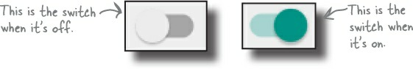
Switch
<Switch
android:id="@+id/switch_view"
android:layout_width="wrap_content"
android:layout_height="wrap_content"
android:textOn="@string/on"
android:textOff="@string/off" />
toggleAlarm.setOnCheckedChangeListener(new CompoundButton.OnCheckedChangeListener() {
@Override
public void onCheckedChanged(CompoundButton buttonView, boolean isChecked) {
if(isChecked) {
Log.d("alarmCheck","ALARM SET TO TRUE");
sched.setAlarm(true);
} else {
Log.d("alarmCheck","ALARM SET TO FALSE");
sched.setAlarm(false);
}
}
});

Slide 65
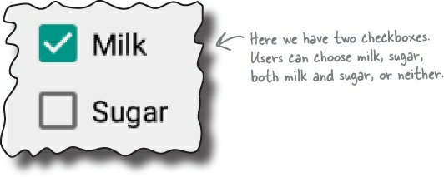
Check boxes
<CheckBox android:id="@+id/checkbox_milk"
android:layout_width="wrap_content"
android:layout_height="wrap_content"
android:text="@string/milk" />
<CheckBox android:id="@+id/checkbox_sugar"
android:layout_width="wrap_content"
android:layout_height="wrap_content"
android:text="@string/sugar" />
toggleAlarm.setOnCheckedChangeListener(new CompoundButton.OnCheckedChangeListener() {
@Override
public void onCheckedChanged(CompoundButton buttonView, boolean isChecked) {
if(isChecked) {
Log.d("alarmCheck","ALARM SET TO TRUE");
sched.setAlarm(true);
} else {
Log.d("alarmCheck","ALARM SET TO FALSE");
sched.setAlarm(false);
}
}
});

Slide 66

Radio Buttons
<RadioGroup android:id="@+id/radio_group"
android:layout_width="match_parent"
android:layout_height="wrap_content"
android:orientation="vertical">
<RadioButton android:id="@+id/radio_cavemen"
android:layout_width="wrap_content"
android:layout_height="wrap_content"
android:text="@string/cavemen"
android:onClick="onRadioButtonClicked" />
<RadioButton android:id="@+id/radio_astronauts"
android:layout_width="wrap_content"
android:layout_height="wrap_content"
android:text="@string/astronauts"
android:onClick="onRadioButtonClicked" />
</RadioGroup>
RadioGroup radioGroup = findViewById(R.id.radioGroup);
int id = radioGroup.getCheckedRadioButtonId();
if (id == -1){
//no item selected
}
else{
RadioButton radioButton = findViewById(id);

Slide 67
Radio Buttons
RadioGroup radioGroup = (RadioGroup)findViewById(R.id.cancle_booking_radio_group);
radioGroup.setOnCheckedChangeListener(new RadioGroup.OnCheckedChangeListener() {
@Override
public void onCheckedChanged(RadioGroup group, int checkedId) {
View radioButton = radioGroup.findViewById(checkedId);
int index = radioGroup.indexOfChild(radioButton);
switch (index) {
case 0:
// perform your action here
break;
case 1:
// perform your action here
break;
case 2:
// perform your action here
break;
case 3:
// perform your action here
break;
case 4:
// perform your action here
break;
}
}
});

Slide 68
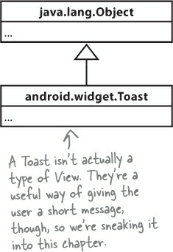
Toasts
CharSequence text = "Hello, I'm a Toast!";
int duration = Toast.LENGTH_SHORT;
Toast toast = Toast.makeText(this, text, duration);
toast.show();

Slide 69
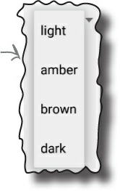
Spinner
<Spinner
android:id="@+id/spinner"
android:layout_width="wrap_content"
android:layout_height="wrap_content"
android:entries="@array/spinner_values" />
<string-array name="spinner_values">
<item>light</item>
<item>amber</item>
<item>brown</item>
<item>dark</item>
</string-array>
Spinner spinner = (Spinner) findViewById(R.id.spinner);
spinner.setOnItemSelectedListener(new OnItemSelectedListener() {
@Override
public void onItemSelected(AdapterView<?> parentView, View selectedItemView, int position, long id) {
String string = String.valueOf(spinner.getSelectedItem());
}
@Override
public void onNothingSelected(AdapterView<?> parentView) {
// your code here
}
});

Slide 70
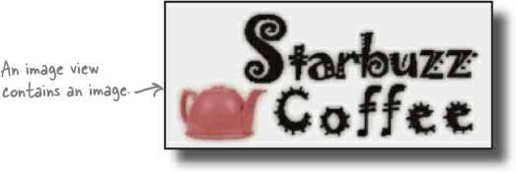
Image View
<ImageView
android:layout_width="200dp"
android:layout_height="100dp"
android:src="@drawable/starbuzz_logo"
/>
ImageView photo = (ImageView)findViewById(R.id.photo);
int image = R.drawable.starbuzz_logo;
String description = "This is the logo";
photo.setImageResource(image);
photo.setContentDescription(description);
Picasso.get().load("https://source.unsplash.com/random/").into(imageView);
Image Button
An image button is just like a button, except it contains an image and no text.

Slide 71
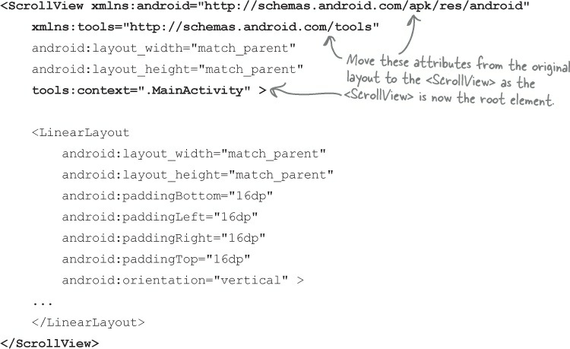
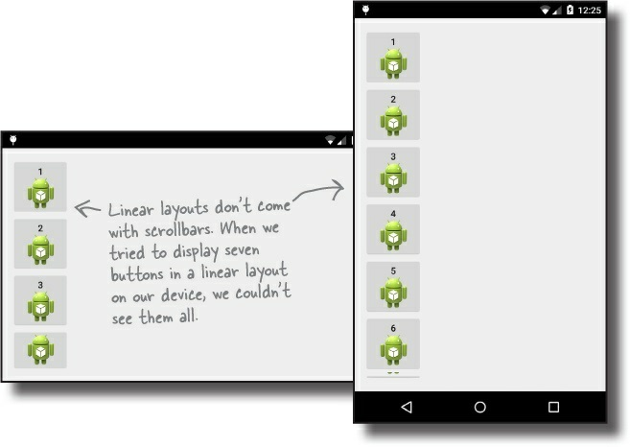
Scroll views

Slide 72
Main Building Blocks – Fragments
Fragment represents a behavior or a portion of UI in an Activity. It is a kind of sub-activity.
Multiple fragments can be combined in a single activity to build a multi-pane UI and reuse a fragment in multiple activities.
You can add or remove fragments in an activity while activity is running.
An activity can contain any number of fragments.
Fragment life cycle is closely related to lifecycle of its host activity which means when activity is paused, all fragments available in activity will also be stopped.
Earlier we had a limitation because we can show only a single activity on screen at one given point in time. So we were not able to divide device screen and control different parts separately.
But with fragment we got more flexibility and removed limitation of having a single activity on screen at a time. Fragments will have their own layout, events and complete lifecycle.
You create fragments by extending Fragment class and you can insert a fragment into your activity layout by declaring fragment in activity's layout file, as a <fragment> element.

Slide 73
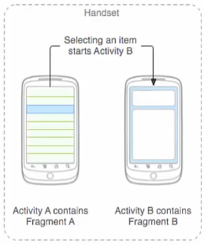
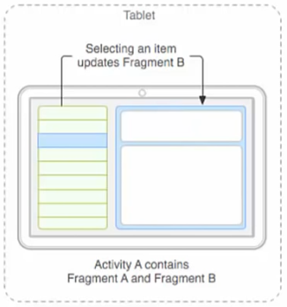
Main Building Blocks – Fragments

Slide 74
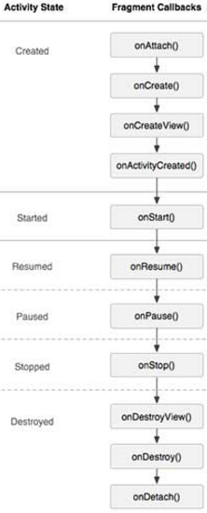
Main Building Blocks – Fragment Lifecycle
Phase I: When a fragment gets created, it goes through following states:
onAttach() // when a frag is attached to its hosting activity
onCreate() //frag is initialized, but no UI
onCreateView() //frag sets up and returns its UI. This view is given to hosting activity afterwards.
onActivityCreated() // Now frag’s life cycle is depending upon its hosting activity’s life cycle
Phase II: When fragment becomes visible, it goes through these states:
onStart() //hosting activity is about to become visible
onResume() // hosting activity is about to become visible and ready for user interaction
Phase III: When fragment goes into background mode, it goes through this states.
onPaused() //hosting activity is visible, but another activity is in the foreground and has focus
onStop() // When hosting activity is not visible

Slide 75
Main Building Blocks – Fragment Lifecycle
Phase IV: When fragment is destroyed, it goes through following states:
onPaused() • onStop()
onDestroyView() //hosting activity is about to be destroyed any frag that it is hosting also has to be shut down
onDestroy() //release frag resources
onDetach() //null out references to hosting activity
Adding Fragments to Activities
Two general ways
First,
Fragment can be statically added to the activity’s layout file.
It is then used in a call to setContentView method.
Second,
Add it programmatically using FragmentManager

Slide 76
Fragment Transaction
FragmentManager manager = getSupportFragmentManager();
FragmentTransaction transaction = manager.beginTransaction();
transaction.replace(R.id.container,YOUR_FRAGMENT_NAME,YOUR_FRAGMENT_STRING_TAG);
transaction.addToBackStack(null);
transaction.commit();

